Slide 1

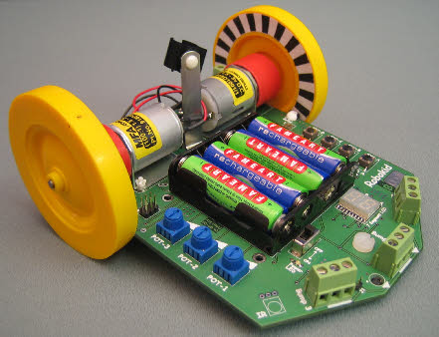

ACTIVITY 2

Slide 2

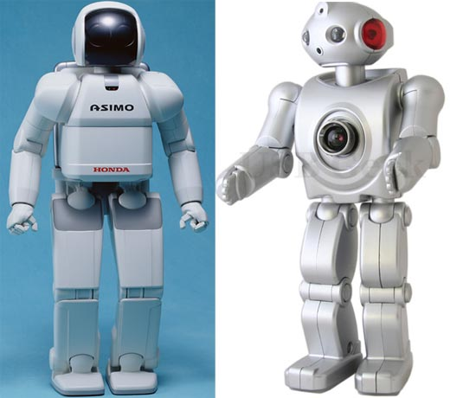
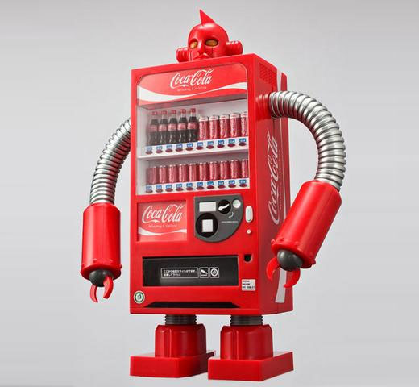
This video shows lots of little short clips of Robots in action!
http://www.youtube.com/watch?v=7cslPMzklVo&feature=player_embedded

Slide 3

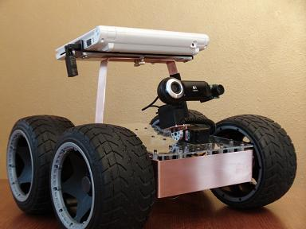
Learn about one of the driving modes and practice steering the robot.

Slide 4

Many robots are connected to a controller by a wire or a wireless link and a person sends commands to the robot through this link. Good examples are the underwater robots used in the North Sea. Here, a person is on a ship and directs the robot through a long cable.
A more complex example is the Mars Rover vehicle, this time the link is by radio rather than cable. Engineers on earth work out a set of moves and then send them to the robot on Mars.

Slide 5
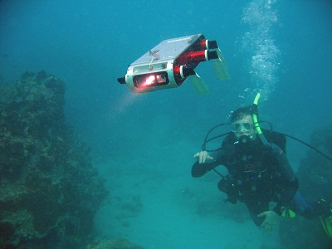
Underwater robots

Slide 6
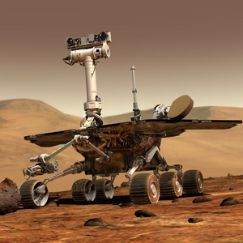
Mars Rover Vehicle

Slide 7

Newer robots are being designed which can be much more independent and can “think” for themselves. These are called autonomous robots. A simple example is the robot vacuum cleaner. It plans its own pattern of cleaning quite independent of a person.

Slide 8

Activity Two is an example of a cable connected robot that needs to be told what to do. Some of the later activities will use the robot as an autonomous robot.

Slide 9

The practical aim is to become familiar with the robot and how to use the switches to put the robot into different modes. Also, you will see how the robot tells you that its batteries need recharging.
If you get the switches wrong then switch off and start again.

Slide 10
Watch DVD | Activity 2 video lasts for about 7 minutes.
Run experiment | For each of the nine different switch positions work out what happens to the robot. The worksheet shows 3 of the 9 conditions. On power on, check the display message as outlined in activity 1. You will be using mode “J1”. Get used to the sequence :: 2A_D_A (press switch A twice, press switch D once, then press switch A once).
Practice | Make up your own obstacle course and to work together as a team to become competent at driving the robot. To begin with it can be quite tricky. The obstacle course should not include tunnels because of the cable.
Tidy | Ensure that the robot is switched off before packing it away. The batteries can be left in the robot.

Slide 11

http://www.youtube.com/watch?v=4tMVZoCSOi8&feature=player_embedded#at=20
Give out and go over worksheet.

Slide 12

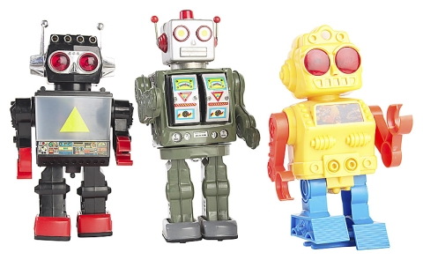
Design and make a cover for the robot.

Slide 13

You will be given time to give your robot some character.
Your cover is to be based on a theme. For example:
    Animal or insect
    Machine
You should think about what design features your machine would have. For example, the lunar rover has an aerial and satellite dish to send and receive signals. It has an on-board camera to take pictures and film of the surface of the moon. It also has two grabbers to allow it to collect moon rock samples.

Slide 14

Plan activity
Team to work together to decide on theme
Create paper/pencil designs showing different ideas and concepts.
Make cover
Before doing a lot of decorative work, check that the cover fits on the robot and can be easily moved to access the switches.

Slide 15

Run robot in mode “J1” (as per activity 2) to check that it does not interfere with the operation of the robot.
Take pictures and video of all the covers.

Slide 16
Let’s have a look at some example covers

Slide 17
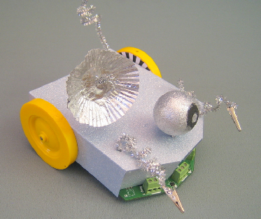
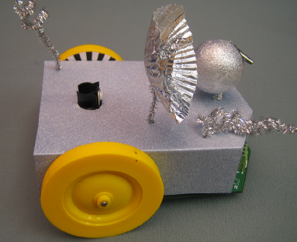
Moon River

Slide 18
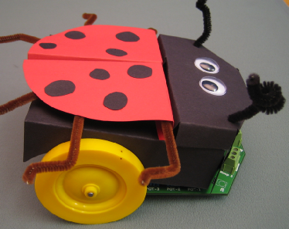
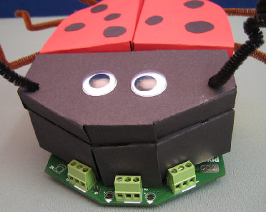
Lady Bird

Slide 19
The supplied template is the simplest that could be devised but it is a bit 2-D. You could experiment with more 3-D structures too.
You will be given a template to ensure that your cover will fit the Robot.
The template should be drawn around and then decorated. Remember that this is the basic template...feel free to build on top of this and be as creative as you can!

